Slide 1
ELECTRICITY BILLING SYSTEM

Slide 2
PRESENTERS
B. KAVYA MANI GAYATHRI – 2010030234
B. SRAVANI - 2010030544

Slide 3
INDEX
INTRODUCTION
PROBLEM STATEMENT
LITERATURE SURVEY
GITHUB SETUP
WORK ALLOCATION
TOOLS REQUIRED
CONCLUSION

Slide 4
INTRODUCTION
This application is developed to manage the activity of Electricity Billing. Admin is the main user of the website who will manage every activity. This project is developed in Java and the database used here is MYSQL using MVC architecture. In the backend, we have used Servlet.
Electricity Billing System project in java is a web application where a user can pays bill online using this system. User can pay Electricity bill online so it will be easy for user. The complete process of Electricity Bill will be managed online. There is no need to maintain record manually.

Slide 5
PROBLEM STATEMENT
Ebilling System is developed to replace all the manual activity through an application. Through this application, the Admin who is the main user of the application will manage all the activities like add users, calculate Bill, and view Payment History etc. The main Objective of Ebilling System is to manage the activity of Billing System. The application will help to manage the users, calculate Bill, Pay Bill, View Payment, History and etc. This application can be used by the Electricity Board.

Slide 6
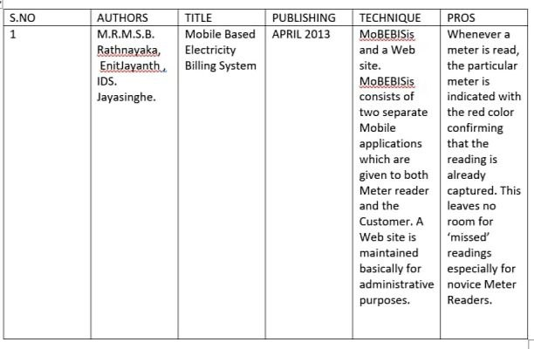
LITERATURE SURVEY

Slide 7
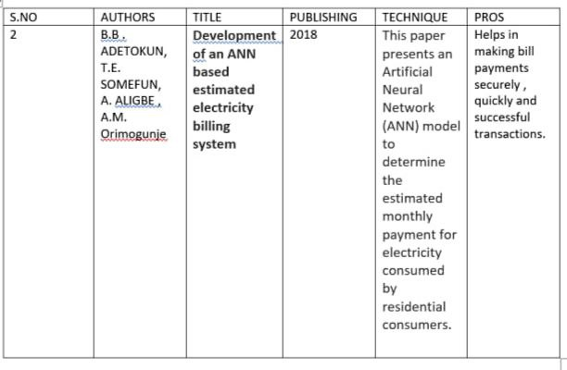

Slide 8
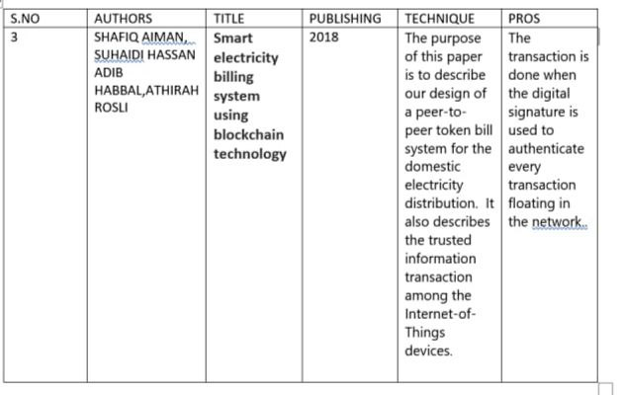

Slide 9
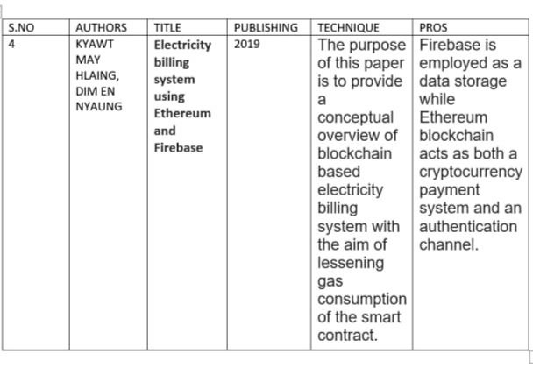

Slide 10
METHODOLOGIES
There are two main users or actors in this application.
ADMIN and USERS.
Admin is the main user here who will manage all the activity such as:
Admin can ADD/VIEW/UPDATE/DELETE users.
Admin can VIEW its profile.
Admin can Calculate Bill for the registered users.
Admin can SEARCH Users.
Admin can VIEW the Bill Report.
Admin can VIEW the Payment History.
Admin can UPDATE the cost of charge/unit .

Slide 11
Users is the another user who will Pay Bill using this application:
User can VIEW/UPDATE its profile.
User can VIEW the Bill.
User can PAY the Bill.
User can VIEW the Payment History.

Slide 12
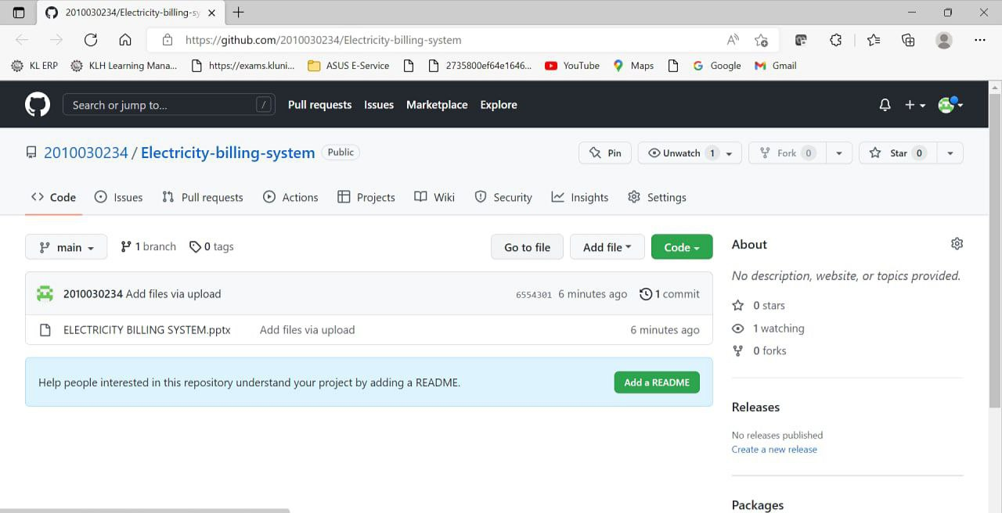
GITHUB COMMITS

Slide 13
WORK ALLOCATION
B, Kavya Mani Gayathri – 2010030234
Front-end , Servlet technology
B. SRAVANI - 2010030544
Backend , Login

Slide 14
TOOLS & TECHNIQUES REQUIRED
CLIENT/SERVER TECHNOLOGY : Servlet
SERVER : APACHE TOMCAT
ECLIPSE IDE
Front-End : JSP, HTML, CSS, JS, BOOTSTRAP
Back-End : MYSQL

Slide 15
CONCLUSION
This Web Application provides facility to Pay Bill Online using this web application. It saves time as it allows number of users to pay the bill online instead of standing in line for bill payment. It is automatically generated by the server.
Administrator has a privilege to create, modify and delete the Users, Add Bill payment and Update cost according to the need.

Slide 16


